Slide 1
CSE 305 Final Project: Travel305
Group: Allan Lee and Nicholas Castro

Slide 2
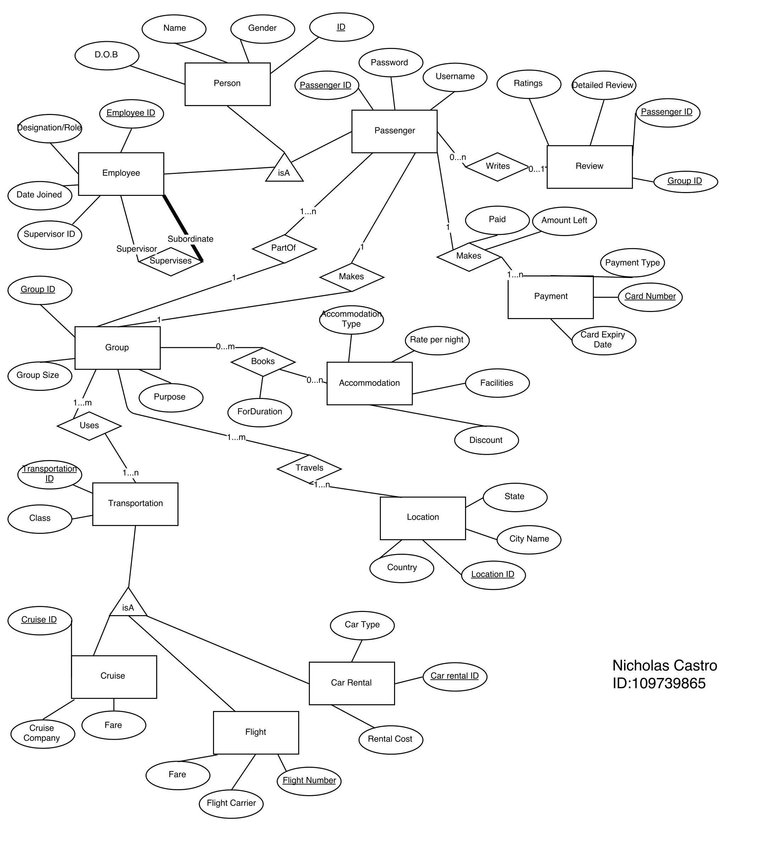
ER Diagram

Slide 3
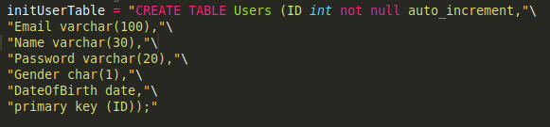
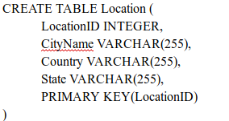
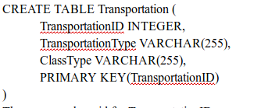
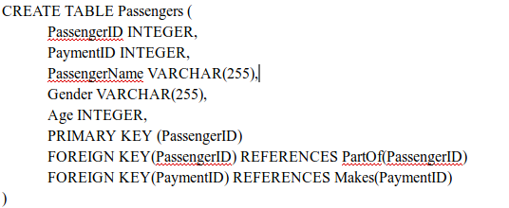
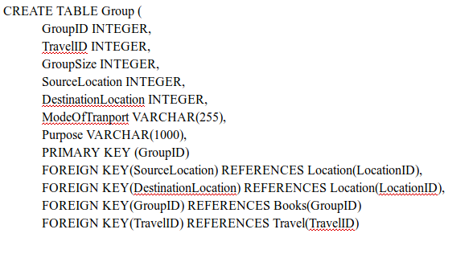
Mapping to SQL

Slide 4
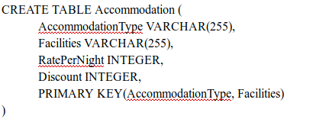
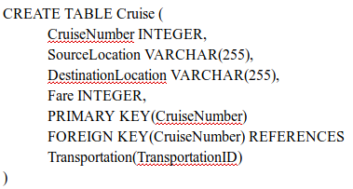
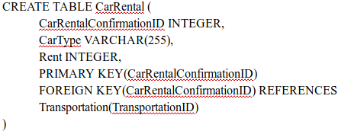
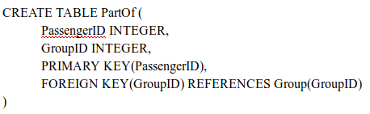
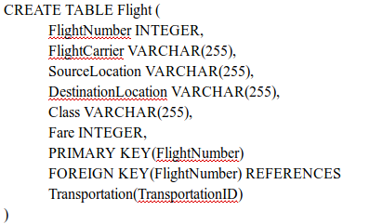
Mapping to SQL cont.

Slide 5
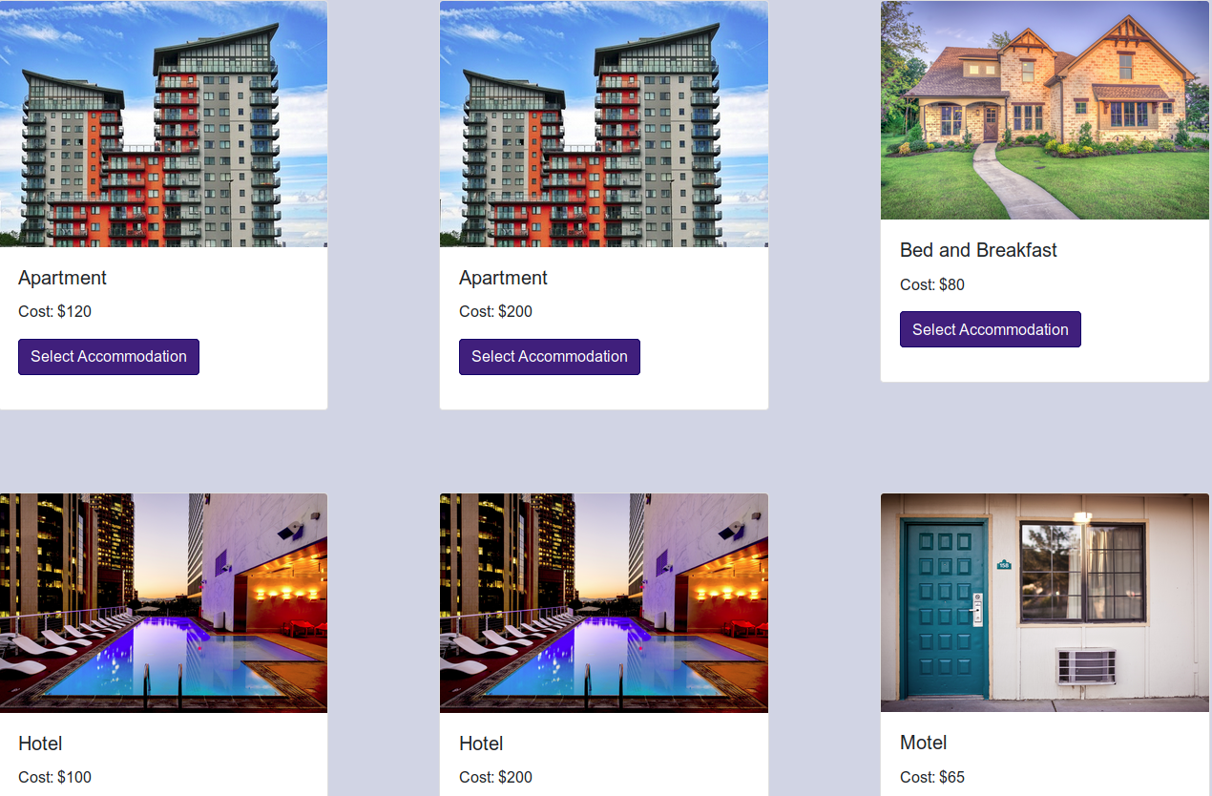
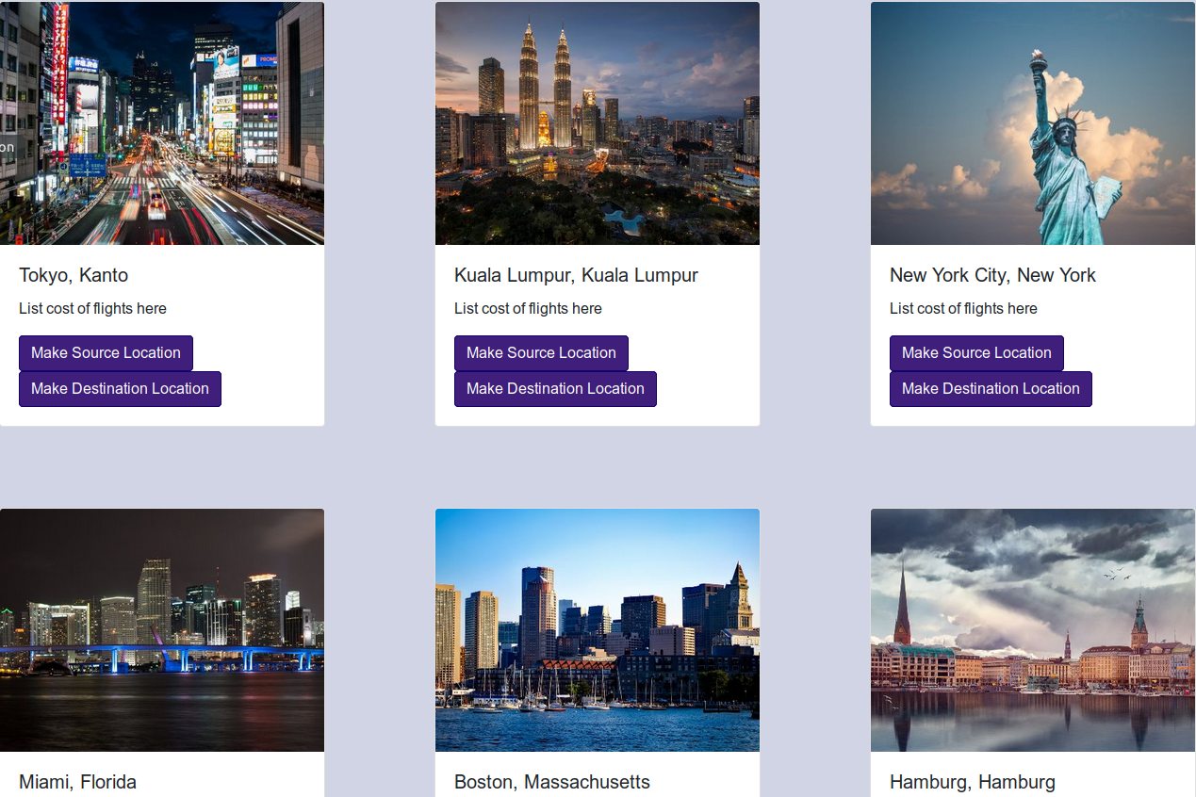
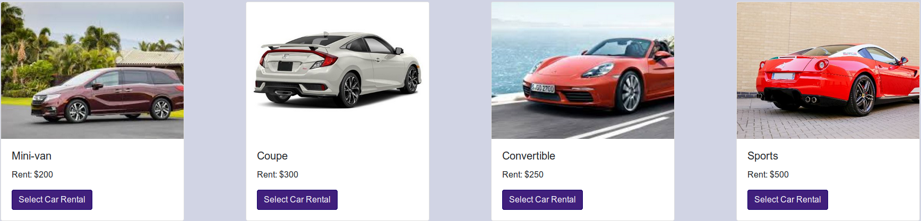
Transaction: Displaying General Information

Slide 6
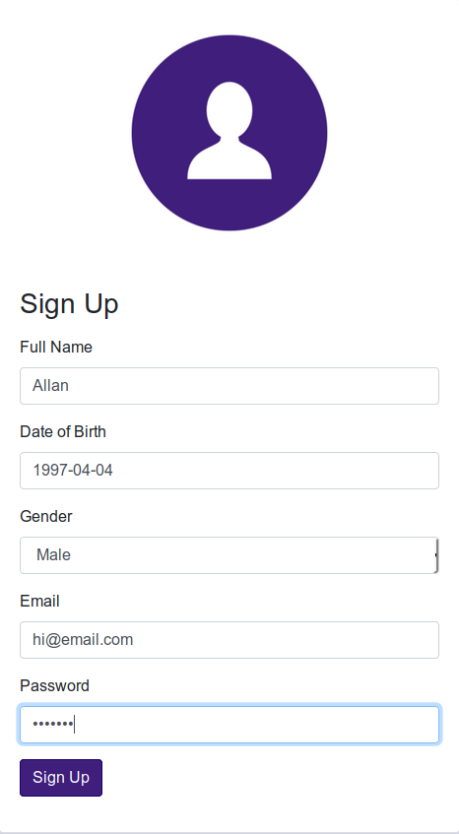
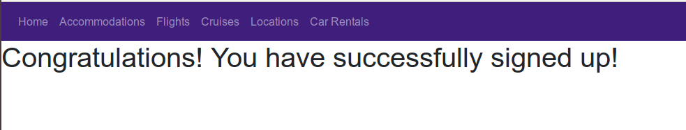
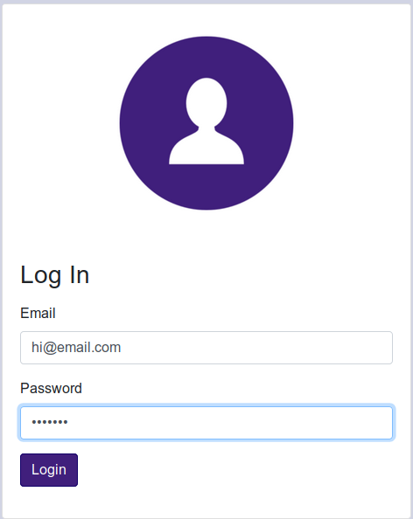
Transaction: Signing Up and Logging In
Click on the sign-up page and enter data in the format shown in the slides. Once done, it’ll redirect you telling you that sign up is successful. Login with the same information and it’ll redirect you to home with a welcome to <your name>. Errors can be detected!

Slide 7
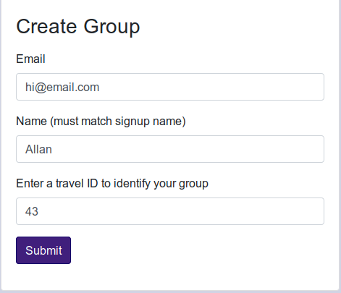
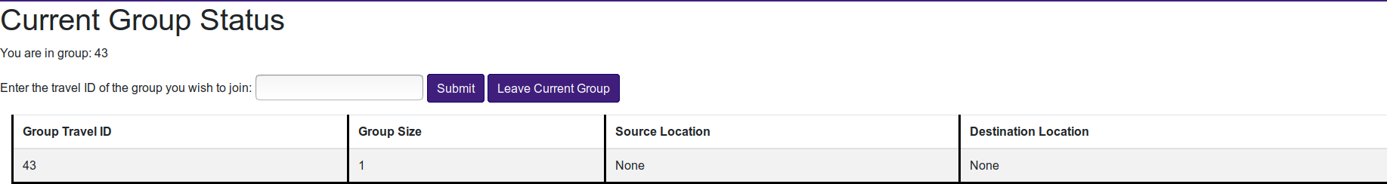
Transaction: Making a Group/Joining a Group
To create a group, enter information you used during sign-up and enter an integer to identify the group. Once the group is made, it will be listed in the “Join Group” page along with your current group status (whether you are in a group or not). It does dynamically check if you are in a group or not along with whether or not you are joining a valid group.

Slide 8
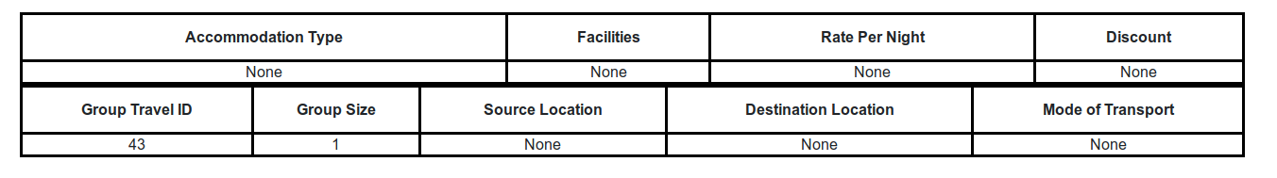
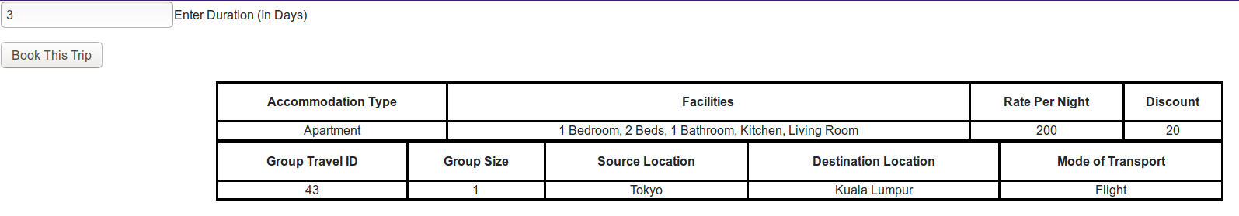
Transaction: Booking a Trip
When you try to book a trip, you must be in a group or it won’t work. You can navigate around the pages and book the appropriate information for location, transport, and accommodation. Once you are done, you select the number of days the trip is for and book it!

Slide 9
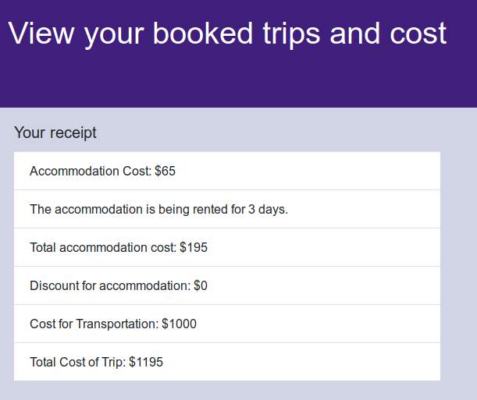
Transaction: Displaying your cost
After booking your trip, it will redirect you to a page displaying your receipt and total cost of the trip!

Slide 10
Contribution
Front End Development: Nicholas Castro
Back End Development: Allan Lee and Nicholas Castro
Database Initialization and Scripting: Allan Lee

